Slide 1
Natural language processing
Hila Levi
May, 2020
© All rights reserved with the author

Slide 2
motivation
Research discipline
Industry related
© All rights reserved with the author

Slide 3
Outline
Few words about Transfer learning
Word embedding
Word2vec, BPE, ELMO
NLP in a nutshell
Language models, Tasks, RNNs, Attention
Transformers
Recent architectures
GPT, BERT, GPT2,…
Transfer learning
Feature transfer
Model transfer
© All rights reserved with the author

Slide 4
Transfer learning
Expected Gains:
1. Higher results
2. Faster convergence
3. Learning from fewer training examples
Labeled data Task 1
Labeled data Task 2
Labeled data Task 3
Feature Transfer (e.g. Elmo)
Model Transfer (e.g. Bert)
Lots of Unlabeled Text Data
Knowledge
© All rights reserved with the author

Slide 5
Feature transfer
(NLP)
Feature transfer = word embedding
Feature transfer =
Better representation includes information:
1. Similarity between words
2. Relations between pairs of words
3. Added syntax / semantic information
4. Using a lower dimension subspace
Labeled data Task 1
Complex task specific model
Better representation
Knowledge
Words in a sentence
© All rights reserved with the author

Slide 6
model transfer
Labeled data Task 1
Replace last layers
MODEL
MODEL
Knowledge
© All rights reserved with the author

Slide 7
Questions?
Knowledge
Questions?
© All rights reserved with the author

Slide 8
Outline
Few words about Transfer learning
Word embedding
Word2vec, BPE, ELMO
NLP in a nutshell
Tasks, Language models, seq2seq, Attention
Transformers
Recent architectures
GPT, BERT, GPT2,…
© All rights reserved with the author

Slide 9
Word embedding
Goal:
Transform the free-text words into numeric values
Word2vec (2013), BPE (2016), ELMO (2018)
Glove, Cove, Fasttext, WordPiece, SentencePiece, …
© All rights reserved with the author

Slide 10
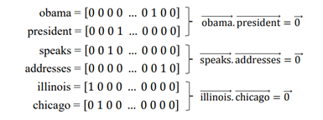
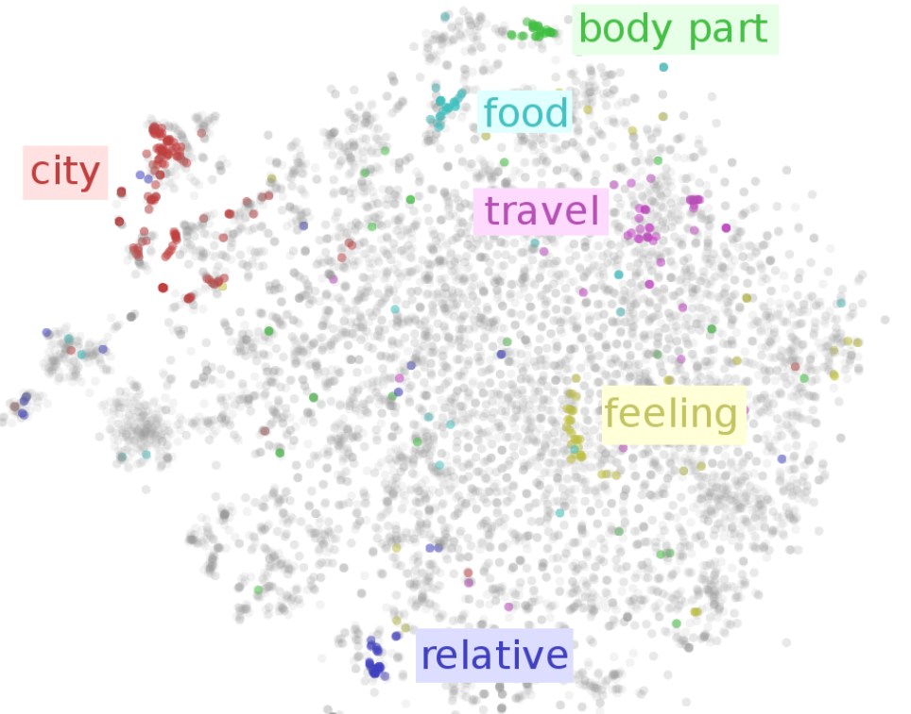
Distributed representation of words
One-hot encoding – on a closed vocabulary
Huge descriptor size$({1e}^{6}$ words - $\left|V\right|={1e}^{6})$
Dot product of any two vectors is 0
An example:
“Obama speaks to the media in Illinois”
“The president addresses the press in Chicago”
Goal:
A mapping to the real continuous m-dim space (m<< $\left|V\right|$)
Similar words are close to each other in the feature space
Dot product → similarity
© All rights reserved with the author

Slide 11
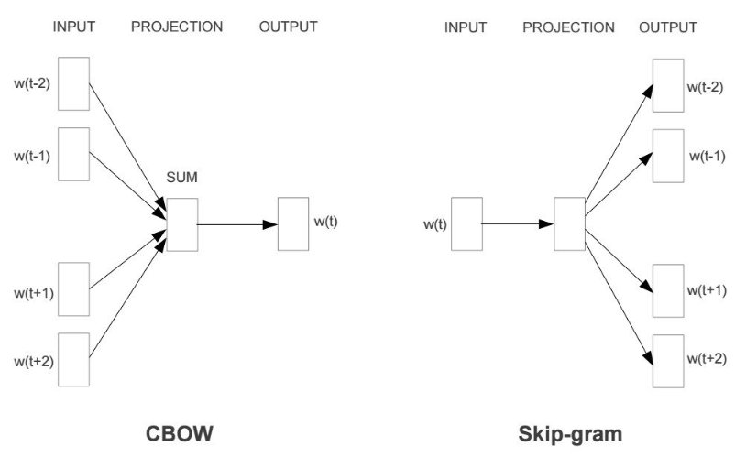
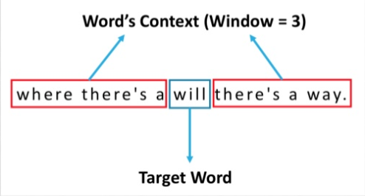
word2vec
“Efficient Estimation of Word Representations in Vector Space”, Mikolov et al, 2013 (Google)
How:
By using context
Self supervised manner
Synonyms
Polysemy X
© All rights reserved with the author

Slide 12
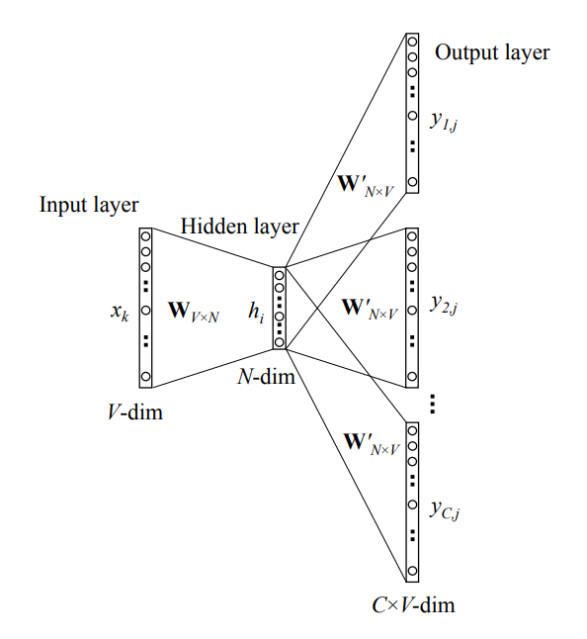
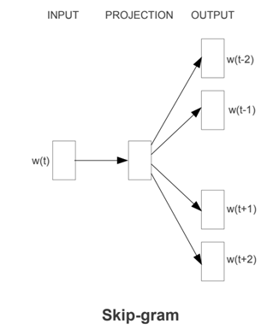
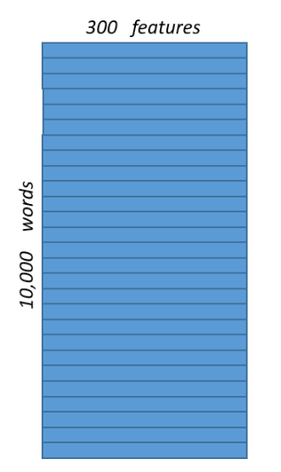
Architecture (skip-gram)
© All rights reserved with the author

Slide 13
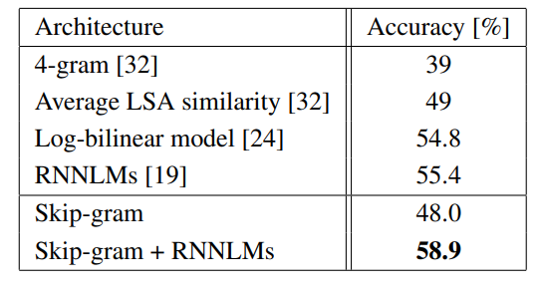
Evaluation
Microsoft sentence completion challenge:
How to evaluate:
1. Sentence completion
2. Descriptor math
3. Transfer learning to downstream tasks
What about relations?
© All rights reserved with the author

Slide 14
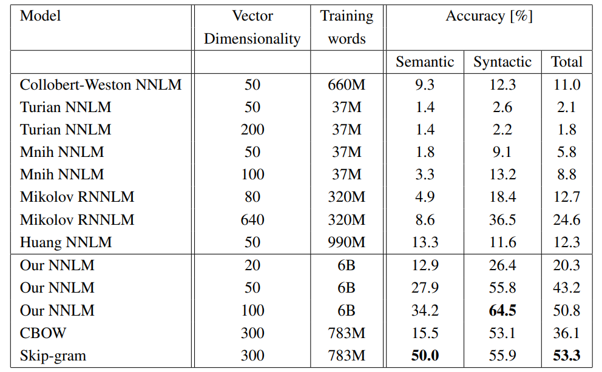
Evaluation (II) – descriptors math
“Efficient Estimation of Word Representations in Vector Space”, Mikolov et al, 2013 (Google)
X = vector(”biggest”)−vector(”big”) + vector(”small”)
© All rights reserved with the author

Slide 15
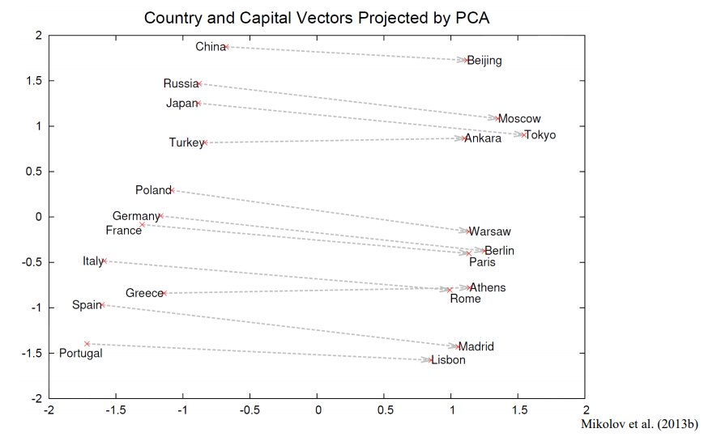
Constant difference vector
f(“Paris”)-f(“France”)+f(“Germany”)=f(“Berlin”)
© All rights reserved with the author

Slide 16
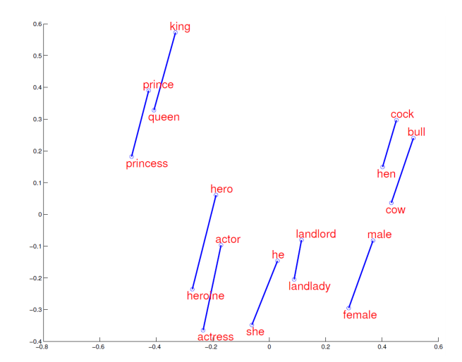
© All rights reserved with the author

Slide 17
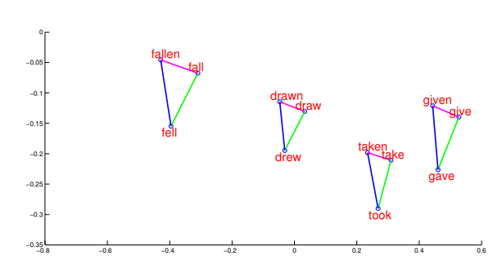
© All rights reserved with the author

Slide 18
Other associations
Iraq - Violence = Jordan
Human - Animal = Ethics
President - Power = Prime Minister
Library - Books = Hall
…
Main disadvantages:
1. Closed word vocabulary
2. Polysemy
© All rights reserved with the author

Slide 19
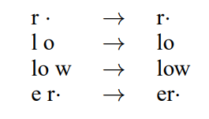
Byte-pair encoding (BPE)
“Neural Machine Translation of Rare Words with Subword Units”, Sennrich et al, 2016
Main disadvantages:
1. Closed word vocabulary
2. Polysemy
Problem - out-of-vocabulary words:
named entities (Barack Obama)
cognates and loanwords (claustrophobia)
morphologically complex words (solar system →Sonnensystem)
Solution – A closed sub-word vocabulary
BPE is actually a frequency-based character concatenating algorithm
Sub-word = concatenated characters
Sub-words
Tokens
© All rights reserved with the author

Slide 20
Word2vec / BPE → feature transfer
Better representation may refer to:
1. Similarity between words
2. Relations between pairs of words
3. Added syntax / semantic information
4. Using a lower dimension subspace
Labeled data Task 1
Complex specific task model
Word2vecBPE
Better representation
Words in a sentence
© All rights reserved with the author

Slide 21
elmo
“Deep contextualized word representations”, Peters et al, 2018 (WU)
Motivation:
Model Polysemy – words may have different meanings in different contexts
Deeper word representations
Contributions:
Represent word vectors also by their context
SOTA results on several downstream tasks
Recent work
Competitive to GPT/BERT
Main disadvantages:
1. Closed vocabulary
2. Polysemy
© All rights reserved with the author

Slide 22
It’s still a pre-trained word embedding model
Complex specific task model
ELMO
Better representation
Words in a sentence
© All rights reserved with the author

Slide 23
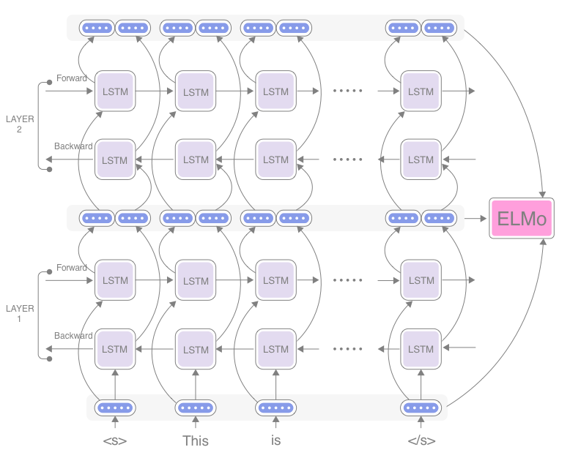
But,
Labeled data Task 1
Evaluated on the fly depending on the specific input and on the downstream task
Task specific
$${∙α}_{1}$$
Complex task specific model
Evaluation mode
$${∙α}_{2}$$
The architecture will be further explained in the next section
Training mode
ELMO - Represents words also by their context
$${∙α}_{3}$$
© All rights reserved with the author

Slide 24
results
© All rights reserved with the author

Slide 25
summary
Several word embedding methods, all are self supervised
Word2vec
BPE (widely used with model transfer architectures)
ELMO (recent architecture, competitive results)
Word embedding = Feature transfer
Terms/Tasks/architecture that should be further explained
© All rights reserved with the author

Slide 26
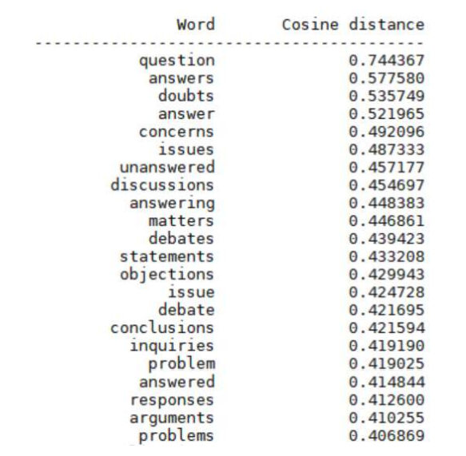
Questions?
© All rights reserved with the author

Slide 27
Outline
Few words about Transfer learning
Word embedding = Feature transfer
NLP in a nutshell
Language models, tasks, recurrence, attention
Transformers
Recent architectures
GPT, BERT, GPT2,…
© All rights reserved with the author

Slide 28
Language models
Language is more than a list of words – lots of syntax and sematic relations
Language modelling goal is to calculate the probability of a sequence of words (sentence):
Can be used to find the probability of the next word in the sequence:
gpt2_demo
Generative task
Self-supervision
© All rights reserved with the author

Slide 29
Downstream tasks (Datasets)
A sequence of words as input
A sequence of words as output
A sequential processing model
Metrics
Computational Models
Language modelling
Perplexity – exponentiation of the entropy. Lower is better
Syntax tasks
Named Entity Recognition (NER)
Part-of-Speech (POS) Tagging
Sentence Acceptability (CoLA)
Semantic tasks
Accuracy / F1
Question Answering (SQuAD, RACE)
Common Sense Reasoning (SWAG)
Semantic Role Labeling (CoNLL2004)
Natural Language Inference (RTE, MNLI, SciTail)
Sentence similarity (MRPC, QQP)
Generative tasks
Machine Translation (WMT)
Question Answering
Summarization
BLUE - bilingual evaluation understudy, higher is better.
Multi-Task benchmark (GLUE)
ROUGE, higher is better.
© All rights reserved with the author

Slide 30
Sequential processing
Trivially modeled with a recurrent network (e.g. RNN), sometimes in an encoder-decoder framework
An auto-regressive model
© All rights reserved with the author

Slide 31
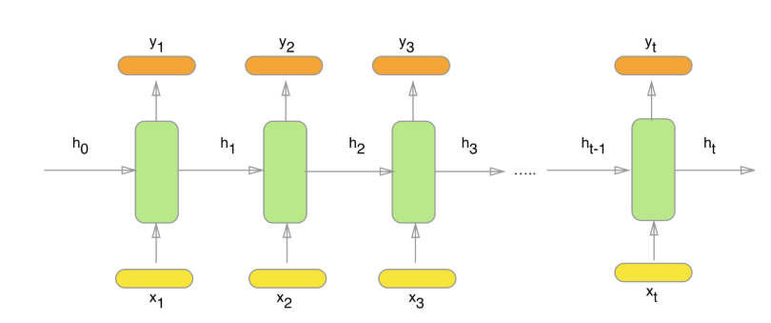
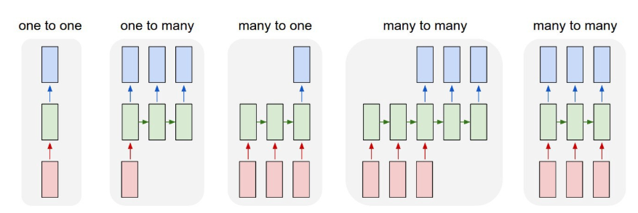
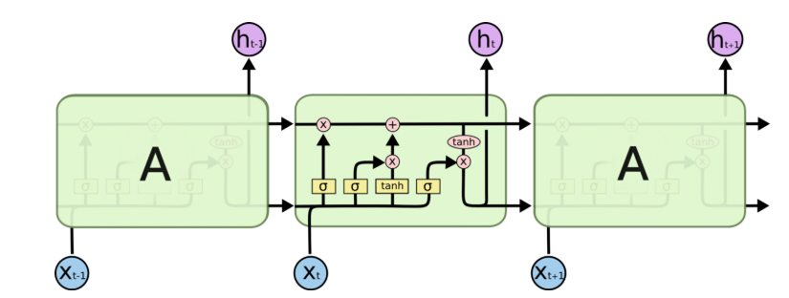
Recap - RNN
model sequence of data (i.e. time series)
LSTM / GRU
© All rights reserved with the author

Slide 32
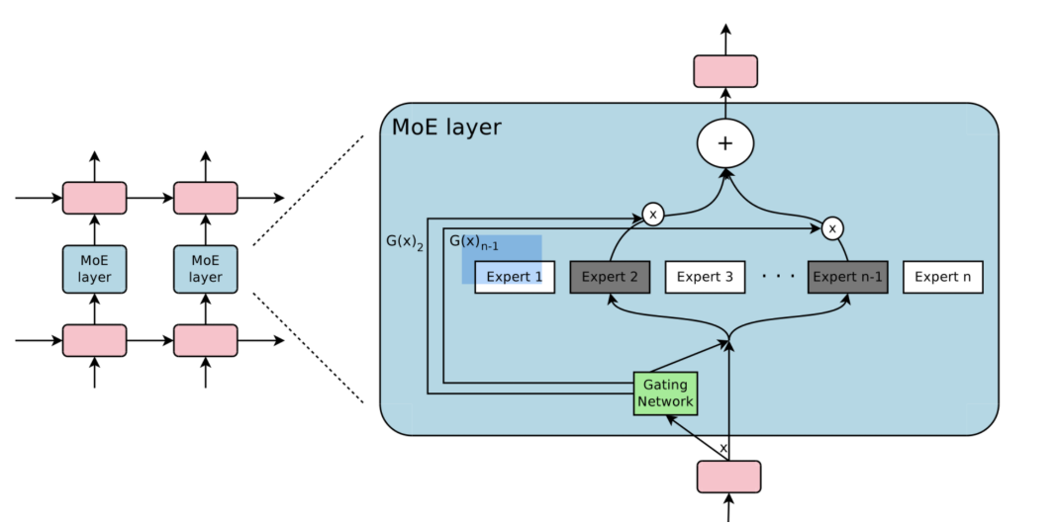
MOE (i)
“Outrageously large neural networks: The sparsely-gated mixture-of-experts layers”, Shazeer et al, 2017
“Outrageously large neural networks: The sparsely-gated mixture-of-experts layers” – Shazeer et al, 2017
© All rights reserved with the author

Slide 33
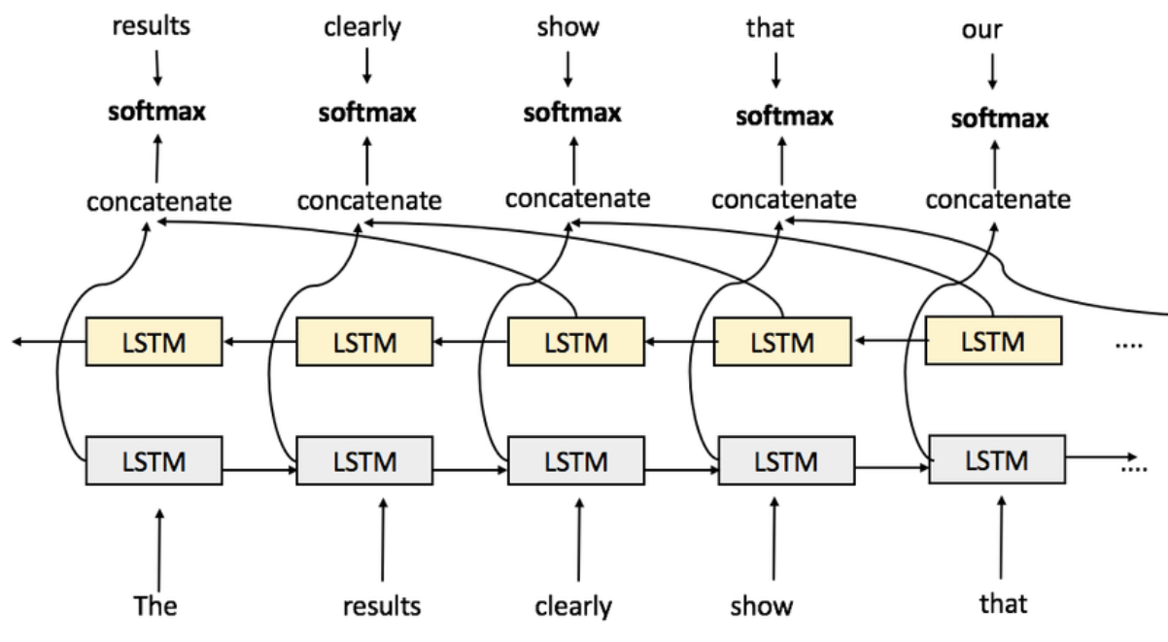
Elmo – 2 layers of biLSTM
“Deep contextualized word representations”, Peters et al, 2018 (WU)
93M parameters
© All rights reserved with the author

Slide 34
Questions?
Avez vous des questions ?
Avez vous des questions
Do you have questions ?
© All rights reserved with the author

Slide 35
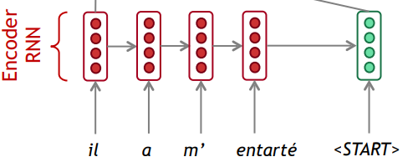
attention
value1
value2
value3
Query
Motivation:
Directly attending the encoders values
Query, Key, Value paradigm
Dot product
s
Normalize → Softmax
Query
Weighted sum
Keys, Values
Decoder
value1
value2
value3
Encoder
Query
Dot product
Normalize → Softmax
Weighted sum
© All rights reserved with the author

Slide 36
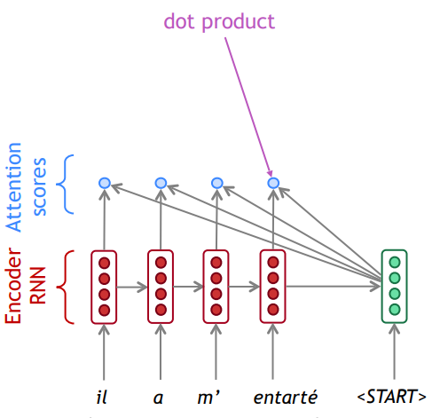
value1
value2
value3
Query
Dot product
Normalize → Softmax
Weighted sum
© All rights reserved with the author

Slide 37
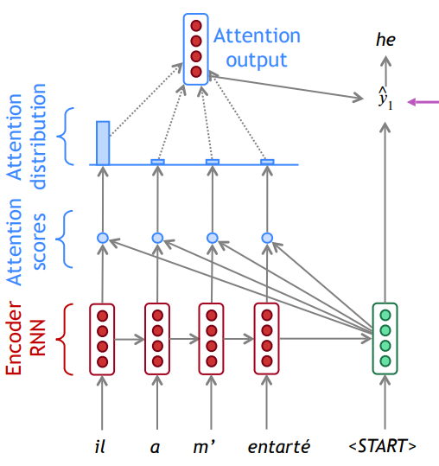
value1
value2
value3
Query
Dot product
Normalize → Softmax
Weighted sum
© All rights reserved with the author

Slide 38
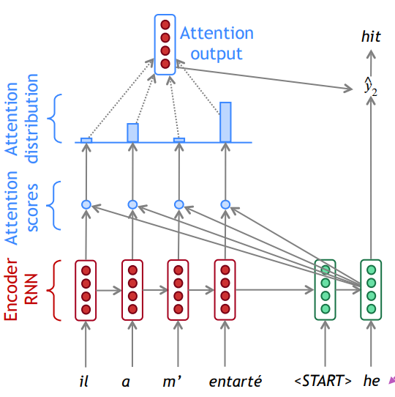
value1
value2
value3
Query
Dot product
Normalize → Softmax
Weighted sum
© All rights reserved with the author

Slide 39
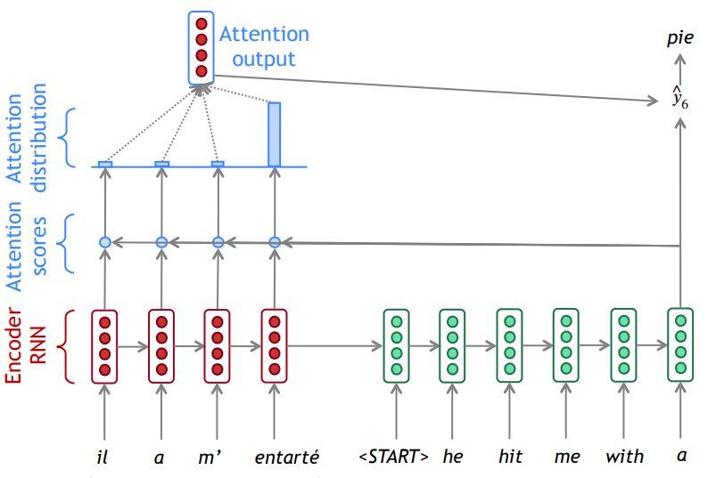
$$Attention\left(q,K,V\right)=softmax\left(q∙K^{T}\right)V$$
$$q$$
$$K^{T}$$
scores
Norm scores
$$V$$
© All rights reserved with the author

Slide 40
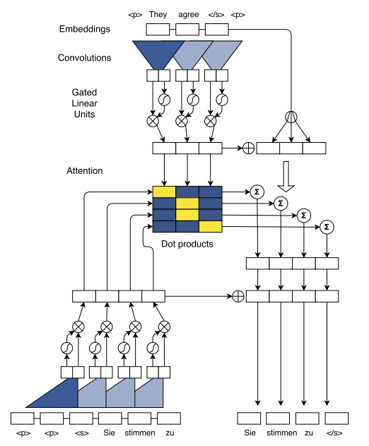
ConvS2s
“Convolutional sequence to sequence learning”, Gehring et al, 2017
© All rights reserved with the author

Slide 41
summary
Language modeling (self-supervised) as a core task
Many downstream tasks with their typical datasets and metrics
Computational models – Recurrence, Attention
Attention mechanism is a promising direction
© All rights reserved with the author

Slide 42
Questions?
Q
t
n
?
s
u
e
i
o
© All rights reserved with the author

Slide 43
Outline
Few words about Transfer learning
Word embedding
Word2vec, BPE, ELMO
NLP in a nutshell
Tasks, Language models, seq2seq, Attention
Transformers
Recent architectures
GPT, BERT, GPT2,…
© All rights reserved with the author

Slide 44
Transformer - background
$$Attention\left(q,K,V\right)=softmax\left(q∙K^{T}\right)V$$
$$q$$
$$K^{T}$$
scores
RNN
RNN
Norm scores
$$V$$
© All rights reserved with the author

Slide 45
RNN / LSTM disadvantages
Attending distant words - “distance” between positions is linear
“The horse didn’t eat the straw because it wasn’t hungry”
“The horse didn’t eat the straw because it wasn’t tasty”
Sequential computation inhibits parallelization
Solved with the self-attention (TRANSFORMER) mechanism
© All rights reserved with the author

Slide 46
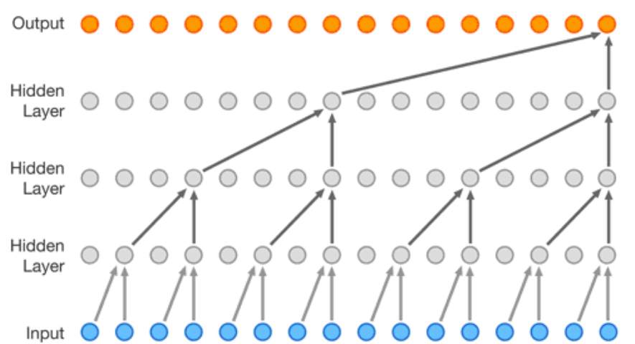
conv disadvantages
Attending distant words - “distance” between positions is logarithmic
Sequential computation inhibits parallelization
Attending by position vs attending by context
Solved with the self -attention mechanism
© All rights reserved with the author

Slide 47
CPUs – race through a series of tasks requiring lots of interactivity
GPUs - break complex problems into thousands or millions of separate tasks and work them out at once
© All rights reserved with the author

Slide 48
Transformer
“Attention Is All You Need”, Vaswani et al, 2017
Motivation:
Replace the RNNs with an attention like mechanism
Contributions:
Relying entirely on attention mechanism
Allows significantly more parallelization (12 hours, 8 GPUs)
SOTA results (translation)
© All rights reserved with the author

Slide 49
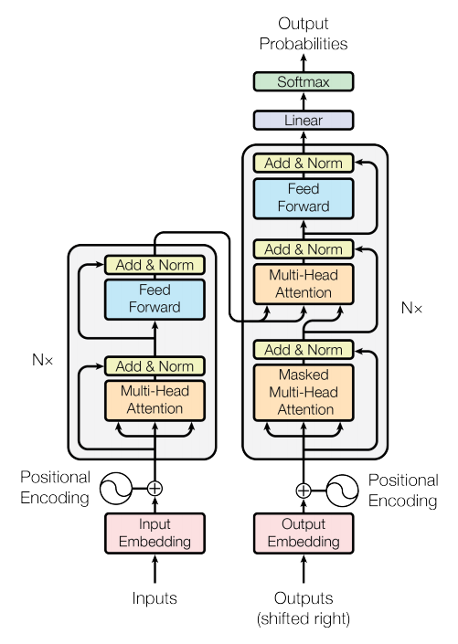
Transformer - architecture
So – where is the difference?
k
v
q
RNN
RNN
© All rights reserved with the author

Slide 50
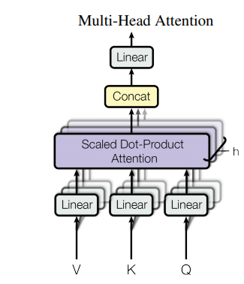
Self-attention layer (encoder)
Dot product
Normalize → Softmax
Weighted sum
scores
value
key
query
Linear
Linear
Linear
Norm scores
© All rights reserved with the author

Slide 51
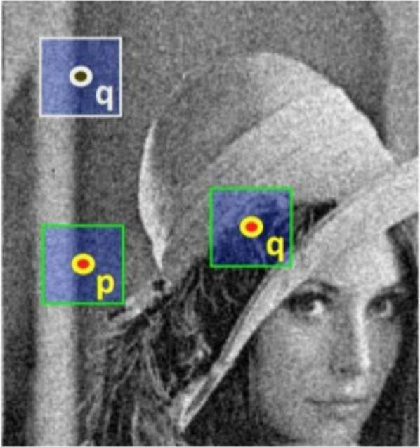
Non Local Module (Deep learning)
f( , )
scores
Norm scores
© All rights reserved with the author
Notes:
In exactly the same manner, the NL module applies the same operations on a feature map
It is formalized with this equation.
Here, x is the input, and y is the output. I is the patch under consideration and j runs over all the patches in the image. C is a normalization factor.
The equation is implemented with matrix multiplication.
Up to now I have talked about an image with patches. It is the same with tensors.
This is our tensor. It has spatial dimensions and channels dimension.
This is xi, these are xjs.
For comparison: Here is a convolution layer. The information for this pixel comes from a local neighbourhood around the pixel with a predefined weights.
The non local module on the other hand summarized information from all the xjs in the featuremap, even those that are far away from our xi, based on their similarity to the xi.
This is A popular similarity function. Theta and phi are just linear functions of x, we calculate their dot product and taking an exponent.
This part, without the exponent, can be implemented with matrix multiplication.
Actually the exponent can be calculated with the normalization factor as a softmax operation.

Slide 52
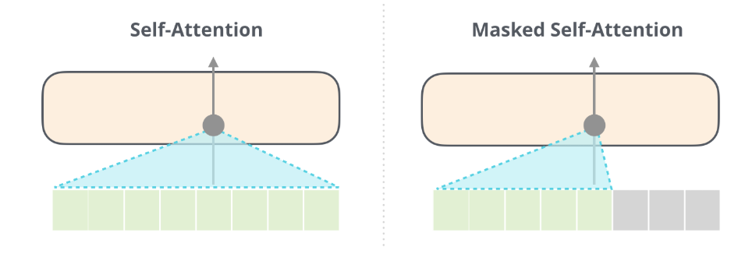
Three different layers of attention
Training mode
k
v
q
scores
ST
Norm scores
© All rights reserved with the author

Slide 53
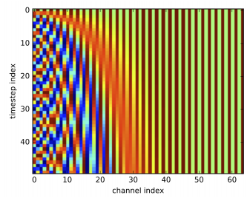
Position encoding
Problem: we have lost the information about the order of the words in the sentence
Solution: position encoding
=
+
$$e_{1}$$
$$e_{2}$$
$$e_{3}$$
$$e_{4}$$
{
N
© All rights reserved with the author

Slide 54
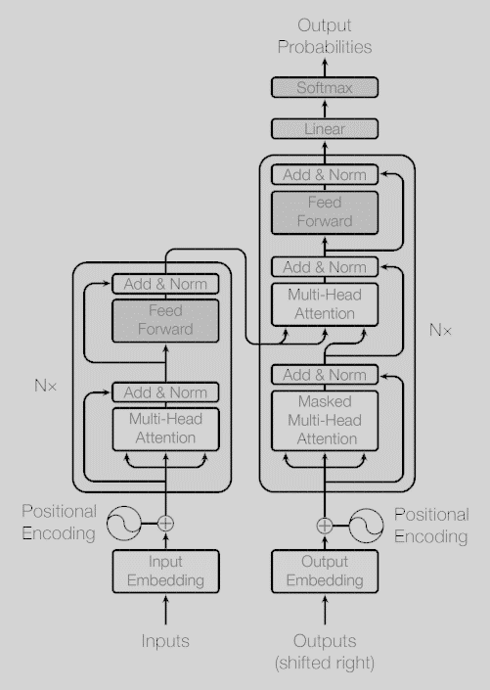
Full processing pipeline
Demo
© All rights reserved with the author

Slide 55
compexity
© All rights reserved with the author

Slide 56
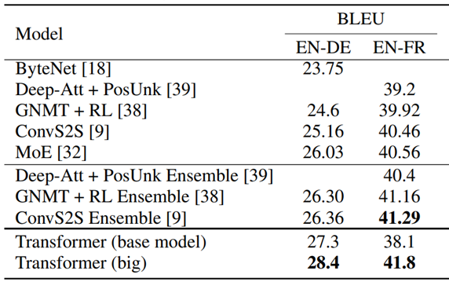
results
© All rights reserved with the author

Slide 57
Questions?
t
q
u
e
s
© All rights reserved with the author

Slide 58
Outline
Few words about Transfer learning
Word embedding
Word2vec, BPE, ELMO
NLP in a nutshell
Tasks, Language models, seq2seq, Attention
Transformers
Recent architectures
GPT, BERT, GPT2,…
Transfer learning
Feature transfer
Model transfer
© All rights reserved with the author

Slide 59
model transfer
Replace last layers
MODEL
MODEL
Knowledge
© All rights reserved with the author

Slide 60
GPT
Improving Language Understanding by Generative Pre-Training”, Radford et al, 2018 (openAI)
Motivation:
Model transfer to target tasks
Contributions:
Model transfer with task specific input adaptations
SOTA results for several downstream tasks
© All rights reserved with the author

Slide 61
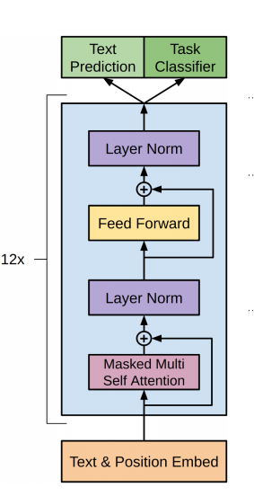
GPT - architecture
Transformer decoder
BPE encoding, learned position embedding
© All rights reserved with the author

Slide 62
GPT - Pretraining
Language modelling objective
© All rights reserved with the author

Slide 63
GPT - finetuning
Finetuning on downstream tasks by
adding a linear output layer
task-specific input transformation
© All rights reserved with the author

Slide 64
Results – natural language inference
© All rights reserved with the author

Slide 65
Results – Question answering
© All rights reserved with the author

Slide 66
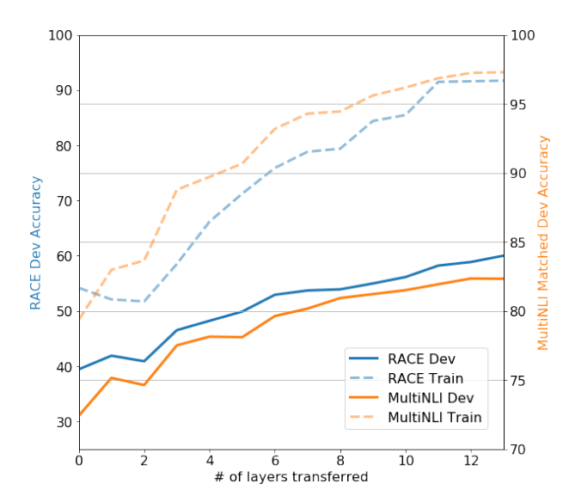
Impact of number of layer transferred
© All rights reserved with the author

Slide 67
Results – ablations (GLUE)
© All rights reserved with the author

Slide 68
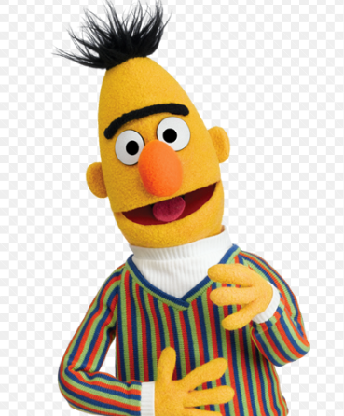
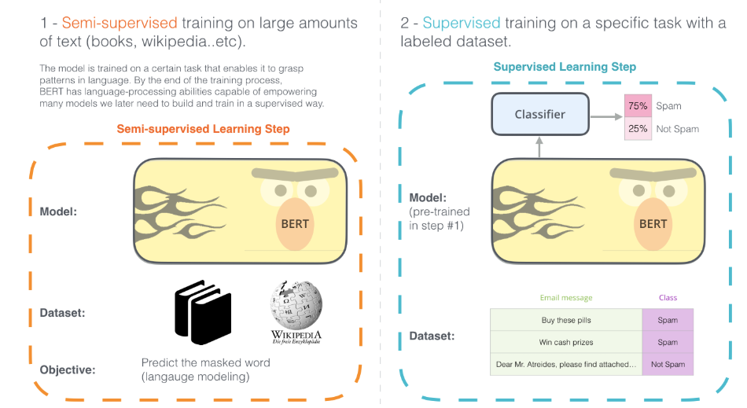
BERT
“BERT: Pre-training of Deep Bidirectional Transformers for Language Understanding”, Devlin et al, 2018 (Google)
Motivation:
Model transfer
Bidirectional processing
Contributions:
Bidirectional training by masked LM
No complex per-task architecture is needed
SOTA results on both sentence level and token level tasks
Bidirectional processing:
ELMO, Transformer encoder
Fill in the blanks
The beginning of a new era in NLP
© All rights reserved with the author

Slide 69
Bert - Architecture
Transformer encoder
BERT-base, 110Mparams (GPT)
BERT-large, 340Mparams
ResNet101:
42M Parameters
© All rights reserved with the author

Slide 70
Bert – input representations
Two sequences of continuous text – handle variety of downstream tasks
Larger training datasets (3.3Gwords)
© All rights reserved with the author

Slide 71
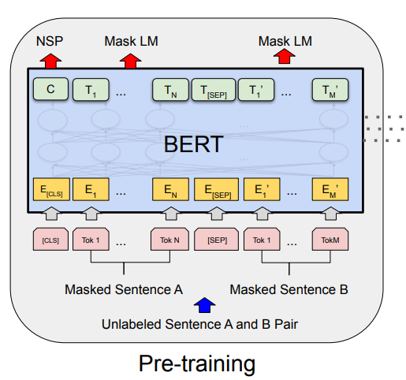
Pre-training bert
Multi-task learning of two different tasks
Masked LM: (allows Bidirectional processing)
Mask 15% of the input tokens at random
Predict the masked token
Next sentence prediction:
Understanding the relationship between two sentences
Binary classification on C
Fill in the blanks
© All rights reserved with the author

Slide 72
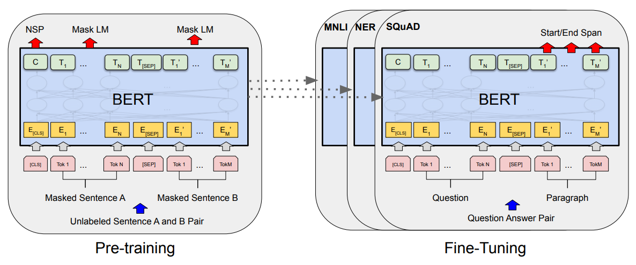
Finetuning bert
Just add the appropriate linear layer!
© All rights reserved with the author

Slide 73
Results - GLUE
© All rights reserved with the author

Slide 74
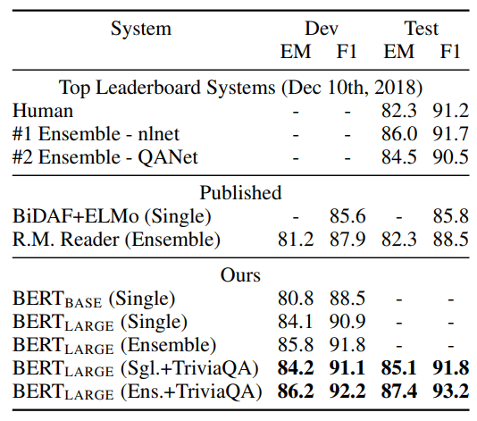
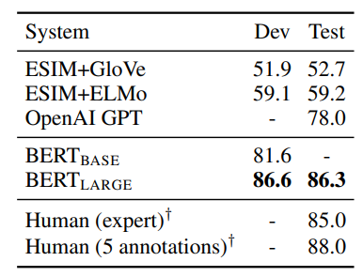
Results – squad v1.1 / SWAG
© All rights reserved with the author

Slide 75
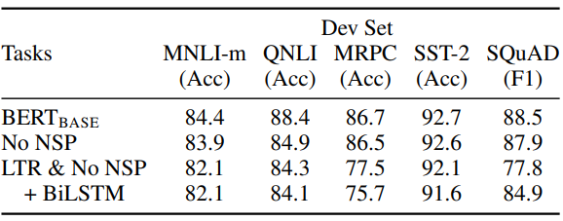
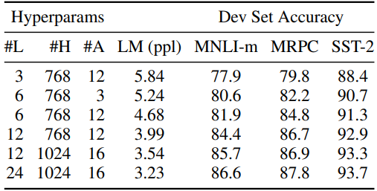
ablations
© All rights reserved with the author

Slide 76
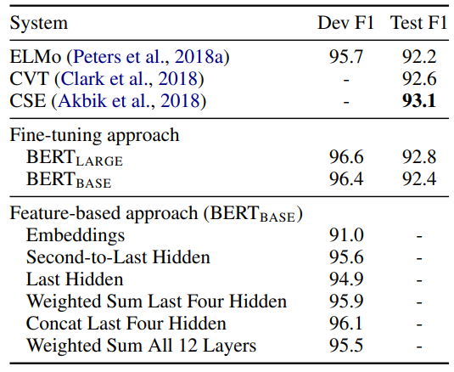
Feature based approach with bert (NER)
Feature transfer has several advantages:
Not all the tasks can be addressed
with model transfer
Computational aspects – use big model to
create word embedding and then run lots of
experiments on a smaller model
© All rights reserved with the author

Slide 77
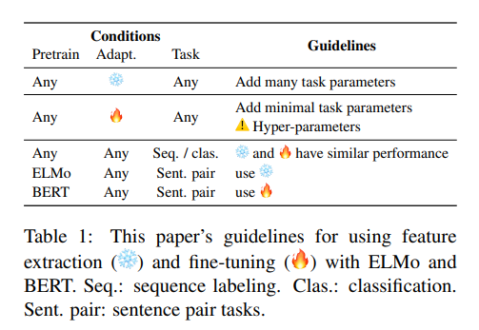
To Tune or Not to Tune? Adapting Pretrained Representations to Diverse Tasks
“To Tune or Not to Tune? Adapting Pretrained Representations to Diverse Tasks”, Peters et al, 2019
© All rights reserved with the author

Slide 78
GPT2
“Language Models are Unsupervised Multitask Learners”, Radford et al, 2019 (openAI)
GPT2 – scaling up GPT advantages
BERT – masked language modelling
(fill in the blanks)
GPT – language modelling
(guess the next word)
Motivation:
Scaling the model, scaling the data
Contributions:
Impressive generative capabilities
Test & demonstrate a zero-shot setting approach
Language modelling:
Disadvantage: unidirectional processing pipeline
Advantage: Allows text generation
© All rights reserved with the author

Slide 79
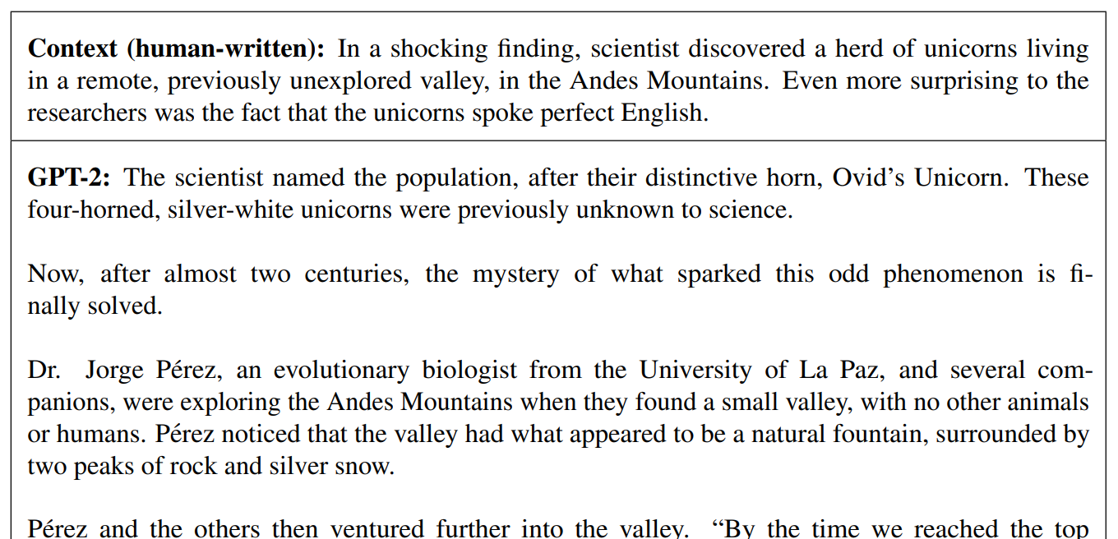
Impressive generative capabilities
© All rights reserved with the author

Slide 80
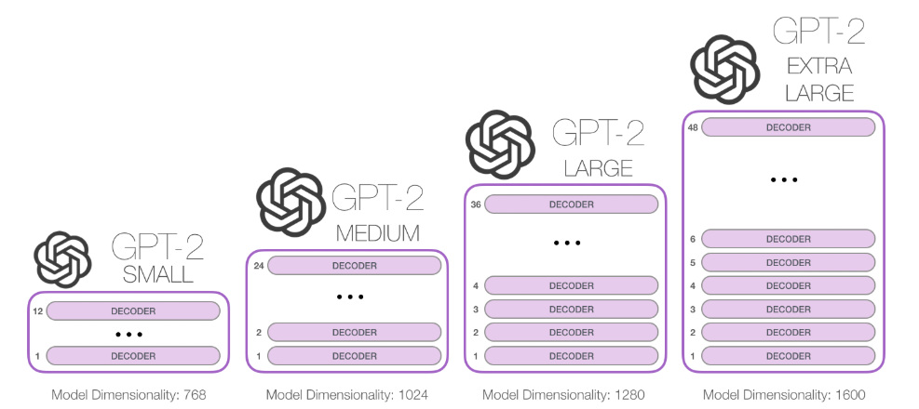
architecture
© All rights reserved with the author

Slide 81
Zero-shot setting
© All rights reserved with the author

Slide 82
model transfer
Labeled data Task 1
Replace last layers
MODEL
MODEL
Knowledge
© All rights reserved with the author

Slide 83
Zero-shot setting
Evaluation only
Labeled data Task 1
Hand crafted heuristics
Input transformation
MODEL
MODEL
Knowledge
© All rights reserved with the author

Slide 84
Results – Language models
Zero-shot setting on domain adaptation
Same task, different training distributions
© All rights reserved with the author

Slide 85
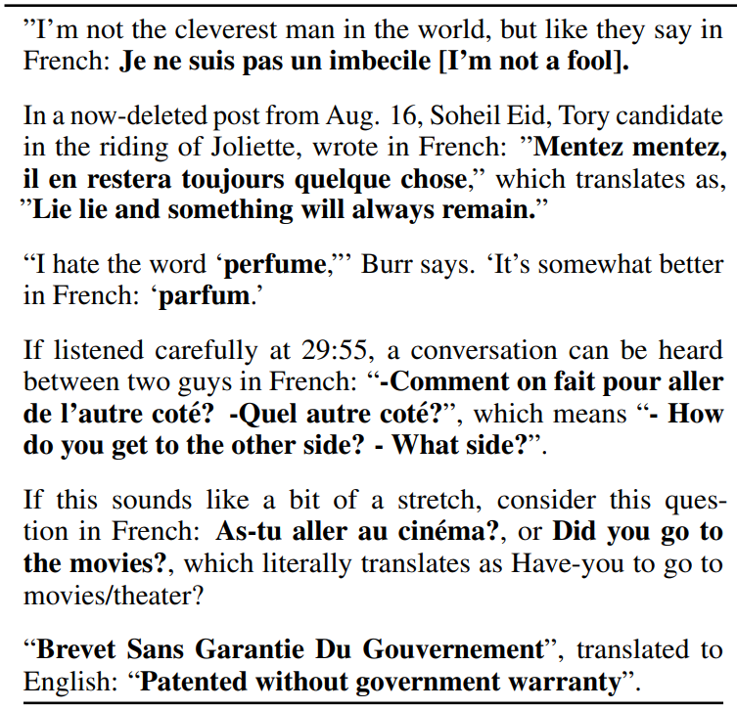
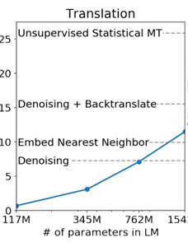
Results – zero shot - Translation
English sentence
In French:
© All rights reserved with the author

Slide 86
Results – zero-shot summarization
Given Text.
GPT2 abstract
TLDR:
© All rights reserved with the author

Slide 87
summary
Transformers
Recent architectures: GPT, BERT, GPT2
Known trends –
Make it larger
Make it cheaper with minimum decrease in the results
Changing connectivity in the self-attention layers
© All rights reserved with the author

Slide 88
Next?
Current trends
Multi-task/Multi-modality
Few shot, Content / Style
Good results on many downstream tasks
Still, Lack of true understanding
Summarization
© All rights reserved with the author

Slide 89
Questions?
© All rights reserved with the author

Slide 90
Non Local Module (Deep learning)
f( , )
scores
Norm scores
© All rights reserved with the author
Notes:
In exactly the same manner, the NL module applies the same operations on a feature map
It is formalized with this equation.
Here, x is the input, and y is the output. I is the patch under consideration and j runs over all the patches in the image. C is a normalization factor.
The equation is implemented with matrix multiplication.
Up to now I have talked about an image with patches. It is the same with tensors.
This is our tensor. It has spatial dimensions and channels dimension.
This is xi, these are xjs.
For comparison: Here is a convolution layer. The information for this pixel comes from a local neighbourhood around the pixel with a predefined weights.
The non local module on the other hand summarized information from all the xjs in the featuremap, even those that are far away from our xi, based on their similarity to the xi.
This is A popular similarity function. Theta and phi are just linear functions of x, we calculate their dot product and taking an exponent.
This part, without the exponent, can be implemented with matrix multiplication.
Actually the exponent can be calculated with the normalization factor as a softmax operation.

Slide 91
Current improvements
Lately, several methods have been presented to improve BERT on either its prediction metrics or computational speed, but not both.
Xlnet & Roberta improvw performance
Distilbert improved inference speed
© All rights reserved with the author

Slide 92
roberta
“RoBERTa: A Robustly Optimized BERT Pretraining Approach”, Liu et al, 2019 (FB)
Contributions:
Retraining of BERT with improved training methodology, larger batch-training sizes and 1000% more data.
Dynamic masking so that the masked token changes during the training epochs.
SOTA results on several benchmarks
© All rights reserved with the author

Slide 93
XLNET
“XLNet: Generalized Autoregressive Pretraining for Language Understanding”, Yang et al, 2019 (CMU)
Contributions:
permutation language modeling, where all tokens are predicted but in random order
Larger data, more computational power to achieve better results on 20 language tasks.
© All rights reserved with the author

Slide 94
distilbert
“DistilBERT, a distilled version of BERT: smaller, faster, cheaper and lighter”, Sanh et al, 2019 (HuggingFace)
Contribution:
learns a distilled version of BERT, retaining 97% performance but using only half the number of parameters
© All rights reserved with the author

Slide 95
albert
“ALBERT: A LITE BERT FOR SELF-SUPERVISED LEARNING OF LANGUAGE REPRESENTATIONS”, Lan et al, 2020 (google)
Contributions
Two parameter reduction techniques:
Factorized embedding parameterization
Cross-layer parameter sharing
© All rights reserved with the author

Slide 96
MASS
“MASS: Masked Sequence to Sequence Pre-training for Language”, Song et al, 2019 (MS)
Contributions:
MAsked Sequence to Sequence pre-training for language generation
significant improvements on several language generation tasks
© All rights reserved with the author

